Slide 1
Modelling of light-tissue interactions

Slide 2
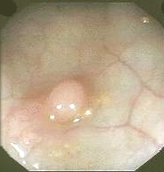
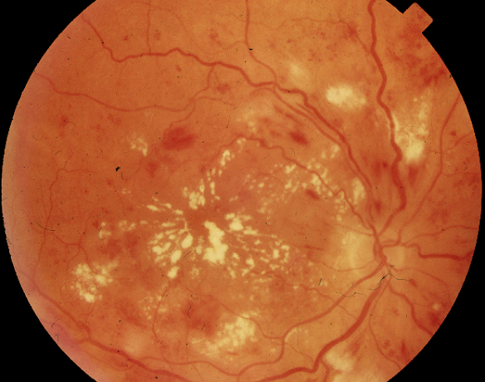
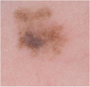
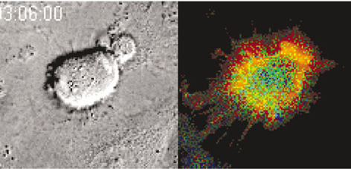
Colour – a carrier of information
Retina
Colon
Cells
Skin

Slide 3
Key ideas
Light emitted by a light source interacts with the interior of a tissue
Through these interactions the spectral composition of light is altered
The remitted spectrum depends on the internal structure and composition of the tissue and in this way encodes its properties
If this encoding is understood, it should be possible to deduce the structure and composition of the tissue from its colour

Slide 4
Key ideas
Disease processes often change the tissue structure and thus the observed colouration
Colour is used in diagnosis and assessment of tissues
The understanding of the image formation process enables us to decipher the colour encoding of tissue properties

Slide 5
How do the colours that we see on the surface arise?

Slide 6
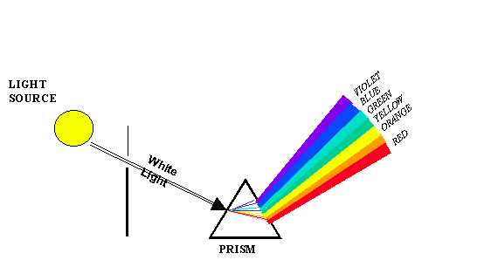
Light interaction with tissue

Slide 7

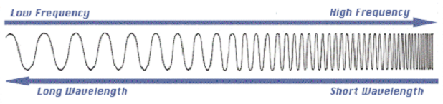
Light – some properties
Amplitude
800 nm = 3.8 x 10¹⁴ Hz
400 nm = 7.5 x 10¹⁴ Hz
c = f ⋅ λ
c – speed of light in a vacuum
f – frequency
λ – wavelength

Slide 8
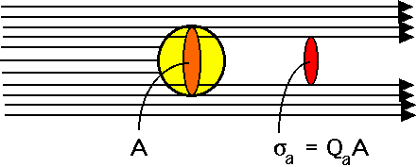
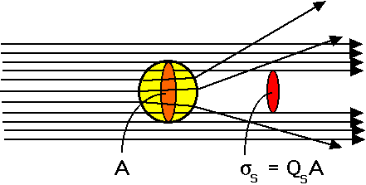
Image formation model
Tissue model
Absorption
Graphs from Steve Jacques’ website
The order of layers
Layer thickness
Optically active components
Type
Quantity
Properties
Scatter
http://omlc.ogi.edu/education/ece532/class3/

Slide 9
Object properties
Absorption
I
Graphs from Steve Jacques’ website
μ_{a}
http://omlc.ogi.edu/education/ece532/class3/

Slide 10
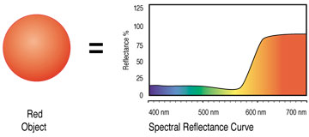

Object properties
Absorption
Red object
Spectral reflectance

Slide 11
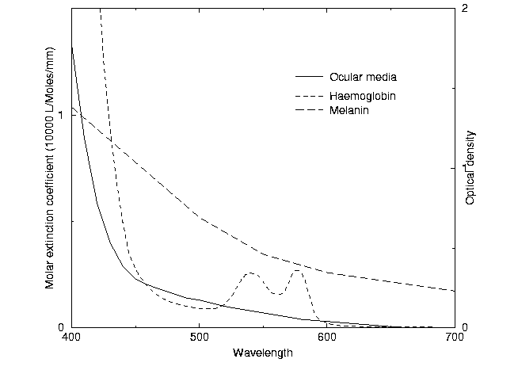
Image formation model
Absorption coefficients

Slide 12
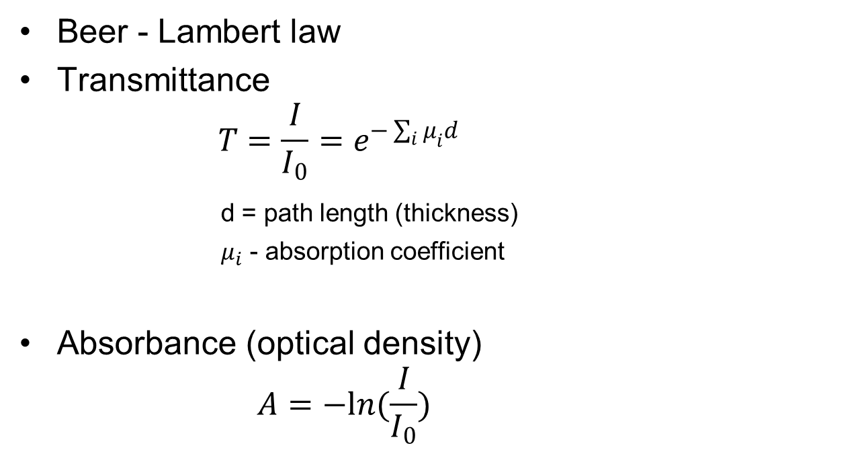
Transmittance and absorbance
Beer - Lambert law
Transmittance
$$T=\frac{I}{I_{0}}=e^{−\sum_{i}{μ_{i}d}}$$
d = path length (thickness)
$μ_{i}$ - absorption coefficient
Absorbance (optical density)
$$A=−ln(\frac{I}{I_{0}})$$

Slide 13
Object properties
Scatter
I
Graphs from Steve Jacques’ website
μ_{s}
http://omlc.ogi.edu/education/ece532/class3/

Slide 14
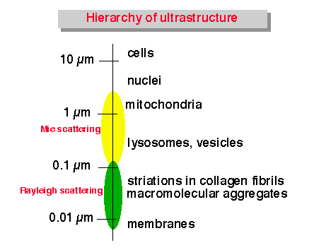
Main tissue scatterers
http://omlc.ogi.edu/education/ece532/class3/

Slide 15
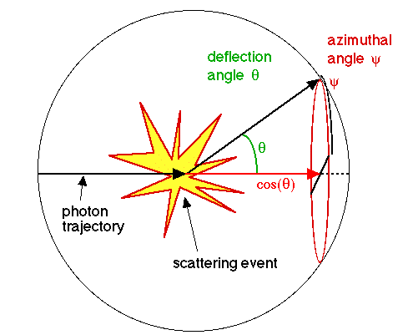
Anisotropy
The anistotropy, g [dimensionless], is a measure of the amount of forward direction retained after a single scattering event. A photon is scattered by a particle so that its trajectory is deflected by a deflection angle. The new trajectory is aligned in the forward direction (shown in red as cos()).
http://omlc.ogi.edu/education/ece532/class3/

Slide 16

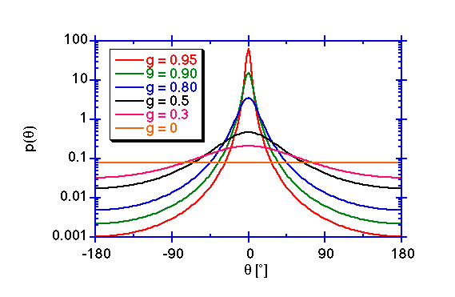
Henyey-Greenstein scattering function
The scattering function, p() [sr⁻¹] describes the probability of a photon scattering into a unit solid angle oriented at an angle relative to the photons original trajectory.
http://omlc.ogi.edu/education/ece532/class3/

Slide 17
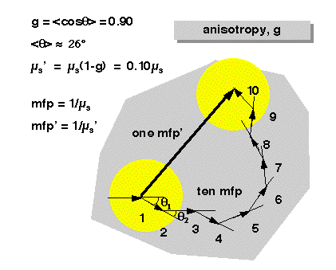
Reduced scattering coefficient
µ_{s}' = µ_{s}(1 - g) [cm⁻¹]
http://omlc.ogi.edu/education/ece532/class3/

Slide 18
Object properties
Scatter

Slide 19
Examples of scatter coefficient

Slide 20
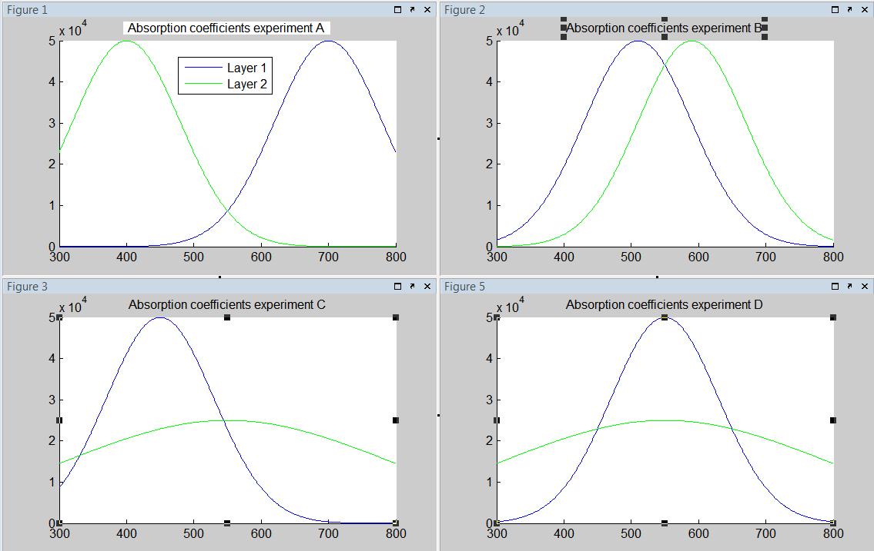
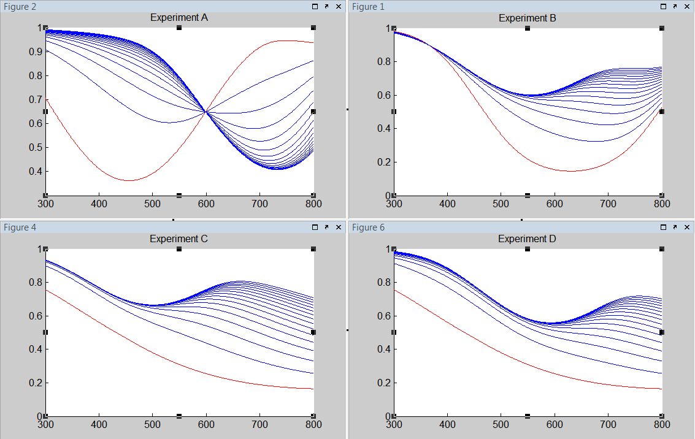
Examples of scatter effects
Reflectance spectra for layers of thickness of Layer 1 from 1 to 15 microns

Slide 21
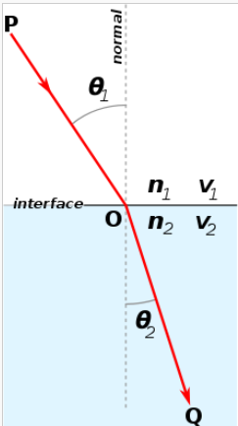

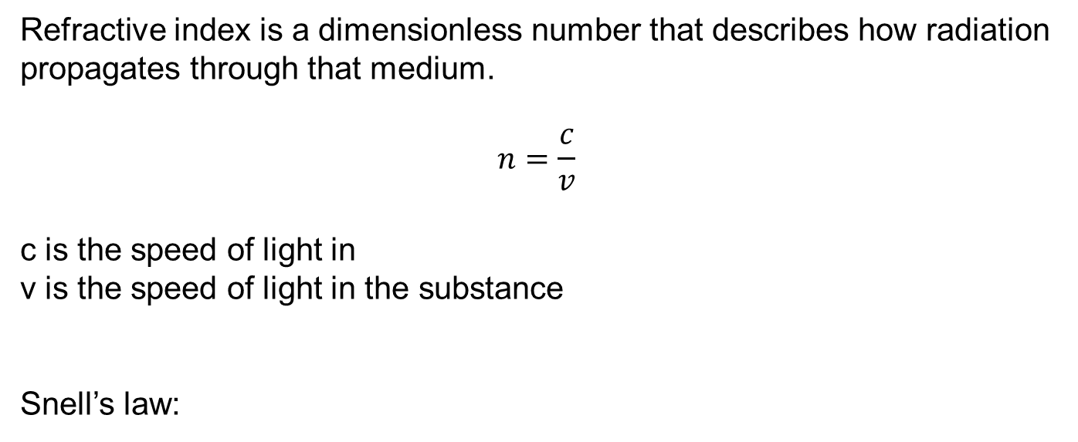
Refraction
Refractive index is a dimensionless number that describes how radiation propagates through that medium.
$$n=\frac{c}{v}$$
c is the speed of light in
v is the speed of light in the substance
Snell’s law:

Slide 22

Skin example

Slide 23
Optical model of the normal skin
Based on physics of image formation
Stratum Corneum
Diffusion
Absorption
Epidermis
Forward scatter
Absorption
Papillary dermis
Backscatter
Forward scatter
Reticular dermis

Slide 24
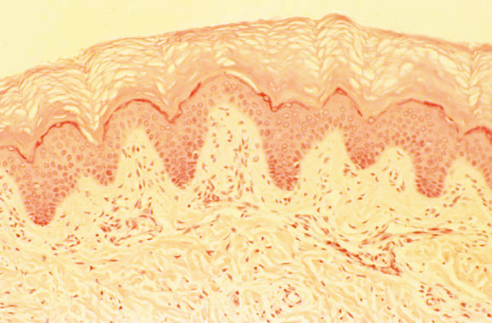
Image formation model
Tissue model
Wavelength (λ) dependent set of absorption coefficients for melanin, μ_{a}^{m}(λ), and the melanin concentration, c^{m}
Stratum corneum
Epidermis
Absorption coefficients for haemoglobin, μ_{a}^{h}(λ), the haemoglobin concentration, c^{h}, the scatter coefficient for collagen, μ_{s}^{pd}, and the thickness of the collagen layer, d^{pd}
Papillary demis
Reticular demis
Image source: http://pathology.mc.duke.edu/research/Histo_course/epi3.jpg
Scatter coefficient, μ_{s}^{rd}, and the layer thickness, d^{rd}
Skin structure and its optical properties

Slide 25

Image formation model
Light – tissue interaction
The incident light interacts with the tissue. As a result of this interaction any remitted light has its spectrum altered depending on the tissue composition.
Incident light
Remitted spectrum
Diffusion
The spectral composition of the light remitted from the skin, R(λ):
R(λ) = Model_of_light_transport( E(λ),μ_{a}^{m}(λ), c^{m}, μ_{a}^{h}(λ), c^{h}, μ_{s}^{pd}, d^{pd}, μ_{s}^{rd}, d^{rd} )
Absorption & forward scatter
Absorption & backscatter
Forward scatter

Slide 26
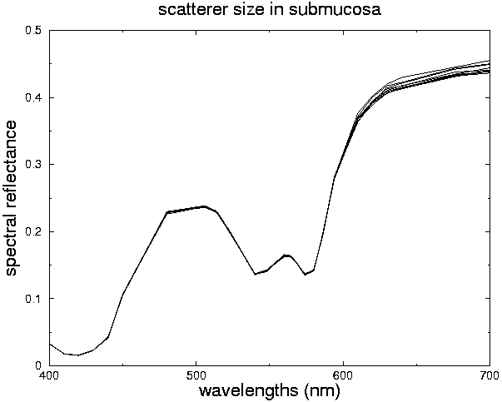
Image formation model
Imaging system
An image vector [i₁ i₂ … i_{n}] is derived from the remitted spectrum R(λ) by convolving it with spectral response functions for the appropriately selected bandpass filters, F₁(λ), F₂(λ),…, F_{n}(λ):
An imaging device captures and integrates specific portions of the remitted spectra and generates a single value for each spectral filter F_{i}.
∞
i₁ =
⌠
R
(
λ
)
F
(
λ
)
d
λ
⌡
1
i₁
i₂
i_{n}
0
∞
i₂ =
⌠
R
(
λ
)
F
(
λ
)
d
λ
⌡
2
0
F₁
F₂
F_{n}
. . . . .
∞
i_{n} =
⌠
R
(
λ
)
F
(
λ
)
d
λ
⌡
n
0

Slide 27
What’s in the image data?
Image data
Spectrum
i_{n}(x) =
∫
I₀(x,λ)
R(x,λ)
F_{n}(λ)
Q(λ)
dλ
Illuminant
Object reflectance
Filter Transmittance
Camera Quantum Efficiency

Slide 28
Tissue reflectance model: the ground truth
Forward model of image formation in abstraction
∫
I₀(x,λ)
R(x,λ)
F_{n}(λ)
Q(λ)
dλ
i_{n}(x) =
Parameters
f = a ° b : P → I
Image values
∀
p ∈ P
i ∈ I
a : P → Λ
b : Λ → I
Spectra
λ ∈ Λ

Slide 29
Prediction (forward mapping)

Slide 30
Absorption and scatter coefficients

Slide 31
Replace by single chosen curves

Slide 32
Forward mapping algorithm
given
incident light
absorption and scatter coefficients for all the components
the spatial arrangement of the components
for all concentrations and thicknesses of parameter p₁
for all concentrations and thicknesses of parameter p₂
. . .
for all concentrations and thicknesses of parameter p_{K}
compute λ = a( p₁, p₂, …, p_{K} )
Physics theory of light propagation in matter
Kubelka-Munk or Monte Carlo
convolve each λ with a set of filter response functions (RGB)
Constants
Parameters
Spectra
Image values

Slide 33
Image formation as a two-step mapping
Parameters
f = a ° b : P → I
Image values
f : P → I
p ∈ P
i ∈ I
a : P → Λ
b : Λ → I
Spectra
λ ∈ Λ

Slide 34
From parameters to spectra

Slide 35
From parameters to spectra

Slide 36
From spectra to colours

Slide 37
Skin colour modelling

Slide 38
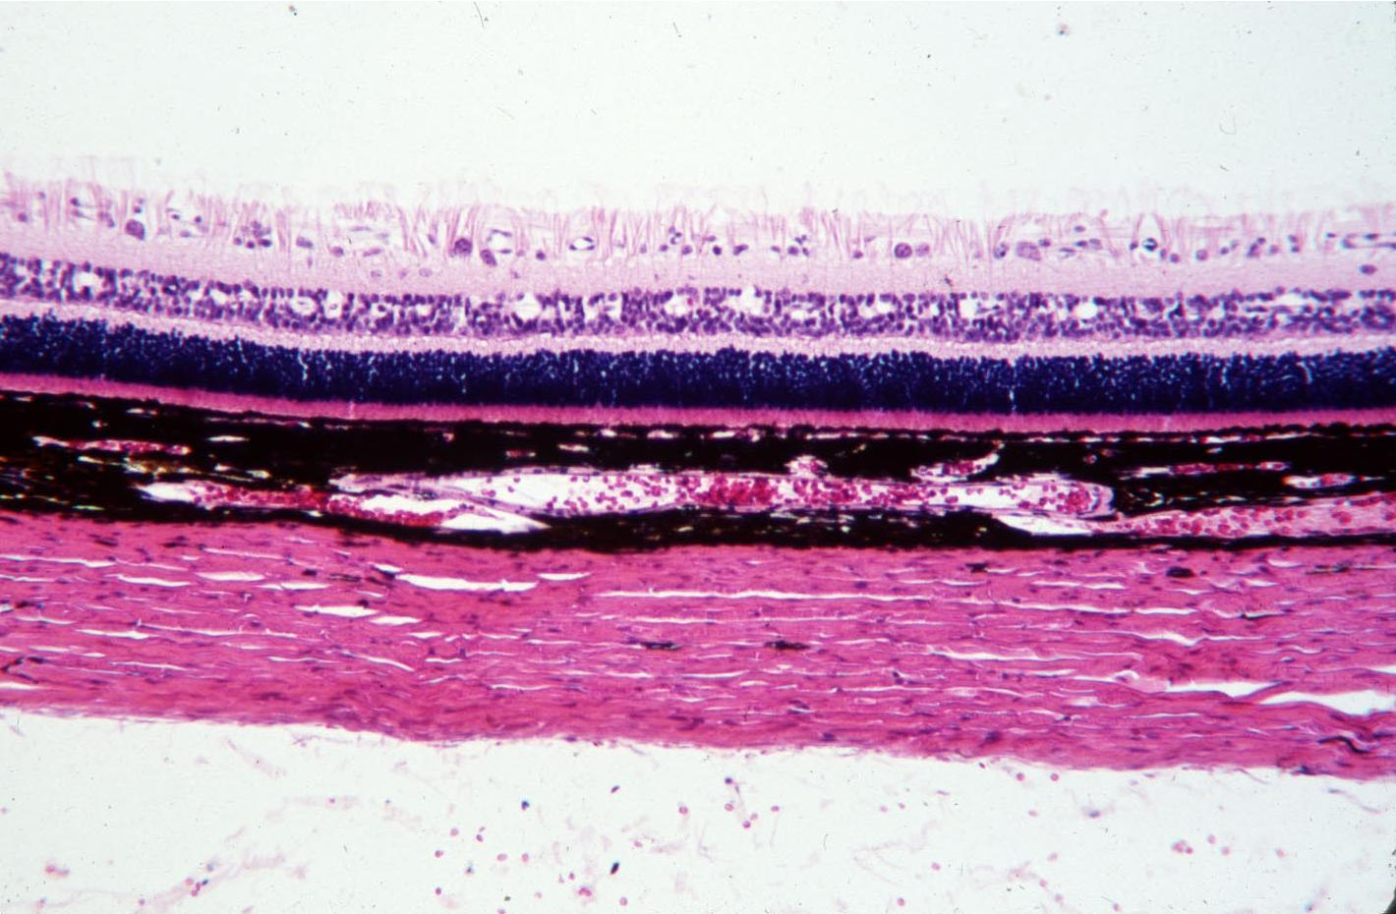
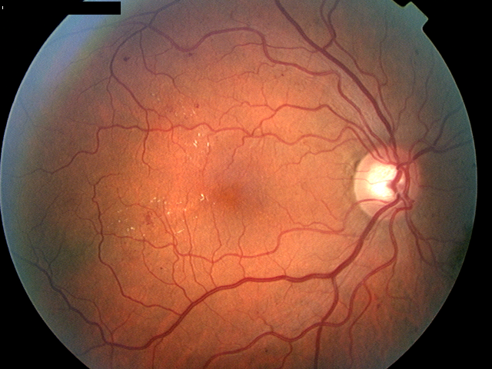
Analysis of the ocular fundus
Incident Light
Remitted Light
Vitreous
Retina
RPE
Choroid
Sclera

Slide 39
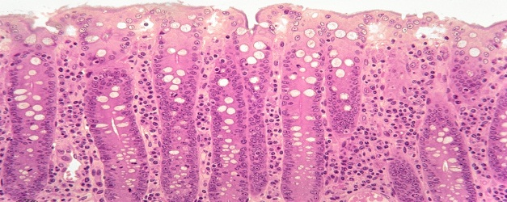
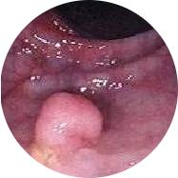





Analysis of colon epithelium
Incident light
Mucosa
Submucosa
Muscularis
externa

Slide 40
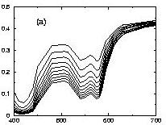
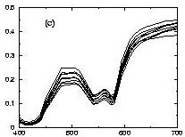
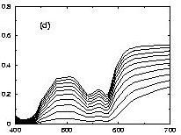
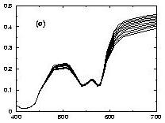
Analysis of colon epithelium
Blood volume fraction
1.07 % - 10.2 %
Size of collagen fibres
100 - 500 µm
intenisty
intenisty
wavelength (nm)
wavelength (nm)
Collagen volume fraction
4 % - 20%
Thickness
395 - 605 µm
intenisty
intenisty
wavelength (nm)
wavelength (nm)

Slide 41
Inverse solution
f ⁻¹ : I → P
Parameters
f = P → I
Image values
p ∈ P
i ∈ I
a : P → Λ
b : Λ → I
Spectra
λ ∈ Λ

Slide 42
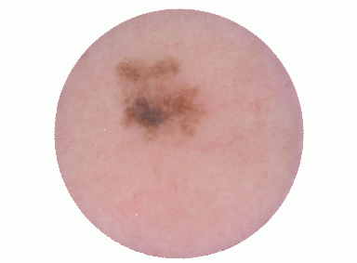
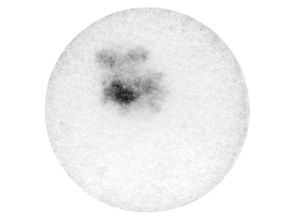
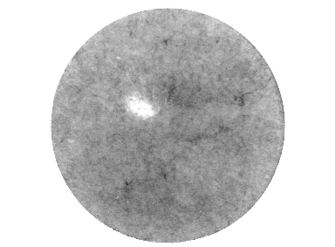
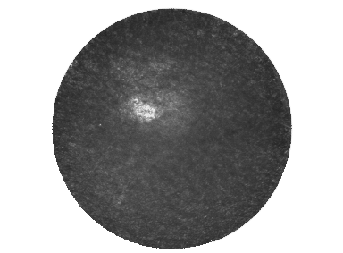
Inverse solution: skin cancer diagnosis
Melanin
Blood
Collagen

